Slide 1
Johnson Liu
Software Engineer, ICM
September 2014
Product Maintenance Training (PMT)
IBM Case Manager V5.2.1
Solution Development: Integration with ICN 2.0.3

Slide 2
Introduction
Course Overview
  Review of the new ICN 2.0.3 features that are utilized in the Case Manager 5.2.1 release
Target Audience:
  Solution Administrators, Solution Developer, L2/L3 support, Sales/Tech Sales, GBS/GTS, Business Partners
Suggested Prerequisites:
  IBM Content Navigator and IBM Case Manager
© Copyright International Business Machines Corporation 2014. All Rights Reserved.
US Government Users Restricted Rights - Use, duplication or disclosure restricted by GSA ADP Schedule Contract with IBM Corp.

Slide 3
Course Roadmap
  Configuring themes with desktops
  Utilizing file tracking
  Utilizing entry templates
  Utilizing add to favorites with sync
  Zero Download Viewer Support
  Social Information for Case Documents
  ICN migration notes

Slide 4
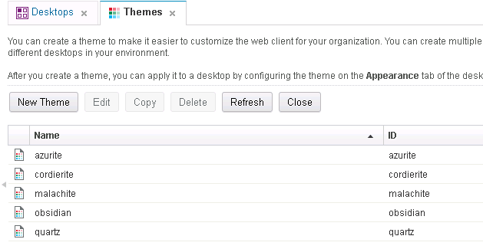
Configuring themes with desktops
Content Navigator 2.0.3 introduces a feature called themes that allows the user to customize desktops with specific colors, fonts, and styles
Five default themes are provided or you can create your own
Makes customizing a desktop with specific logos or banners much simpler than in prior releases

Slide 5
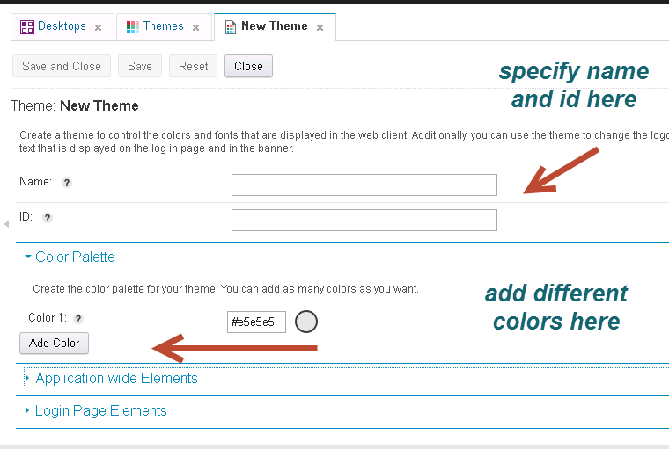
Configuring themes with desktops
To configure themes from ICN, navigate to the ICN Admin Page on http://hostname:port/navigator/?desktop=admin
To create a new custom theme, select “new theme”

Slide 6
Configuring themes with desktops
Application-wide elements:
  Font family
  Framework color
  Selected item color
  Global toolbar color
  Link color
Login Page Elements
  Login page background color
  Login pane background color
  Text color
  Login page logo
  Copyright text
Banner Elements
  Background color
  Banner fill style
  Text and icon color
  Banner logo
  Product name
Navigation Elements
  Background color
  Icon color
  Selected icon color
Buttons
  Style
  Background color
  Text and icon color

Slide 7
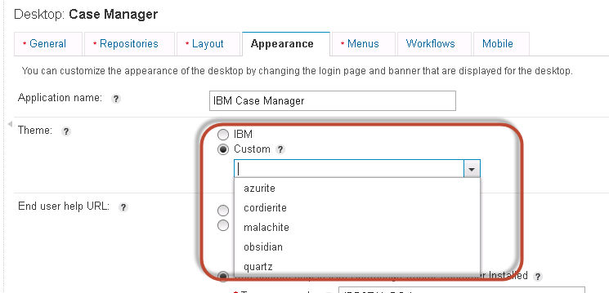
Configuring themes with desktops
To assign a theme to a Case Manager desktop, navigate to the Desktops pane and edit the appropriate Desktop
Navigate to the Appearance tab and select a theme

Slide 8
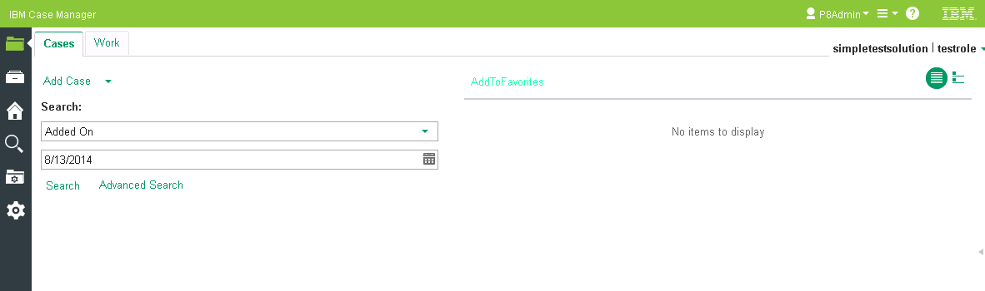
Configuring themes with desktops
View of IBM Case Manager with “malachite” theme
Landing page

Slide 9
Course Roadmap
  Configuring themes with desktops
  Utilizing file tracker
  Utilizing entry templates
  Utilizing add to favorites with sync
  Zero Download Viewer Support
  Social Information for Case Documents
  ICN migration notes

Slide 10
Utilizing file tracker
The Content Navigator 2.0.3 file tracker feature allows users to specify where, by default, files should be downloaded. Choices include
  A local folder
  A shared folder on a file server
  A path specified using environment variables
Other default behaviors can also be configured, including
  Always overwrite existing files
  Always open the file after completing the download
  Delete the local copy of the file following an add or check in

Slide 11
Utilizing file tracker
To enable file tracker, navigate to the ICN admin page and go to the Case Manager desktop
In the General tab, select enable for file tracking
When file tracker is enabled, this is available for all users that have access to the desktop

Slide 12
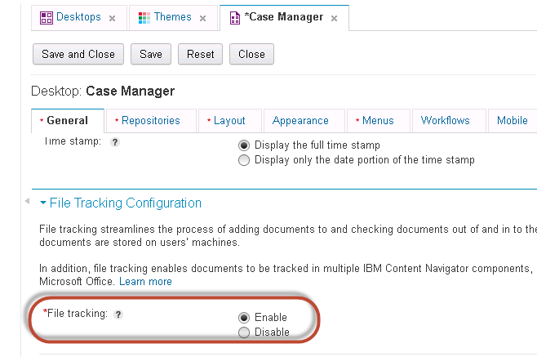
Utilizing file tracker

Slide 13
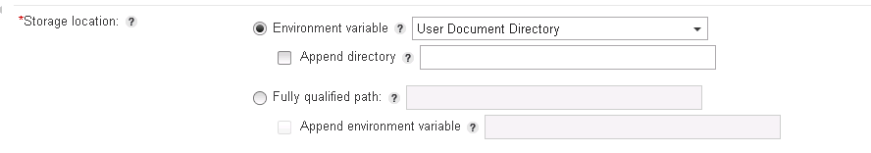
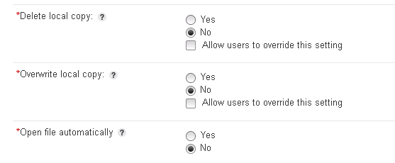
Utilizing file tracker
In the storage location, set up the location for the downloads
Set up the other options in order to configure file tracker

Slide 14
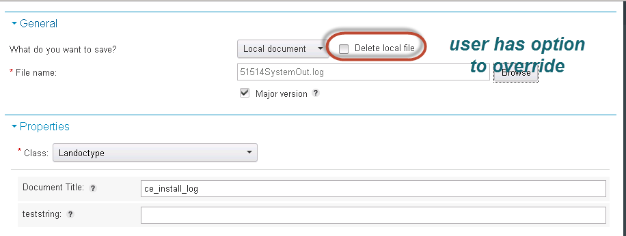
Utilizing file tracker
With file tracking enabled, in Case Client when you check in a document, we can invoke the file tracker dialog when we click browse (based on Java)

Slide 15
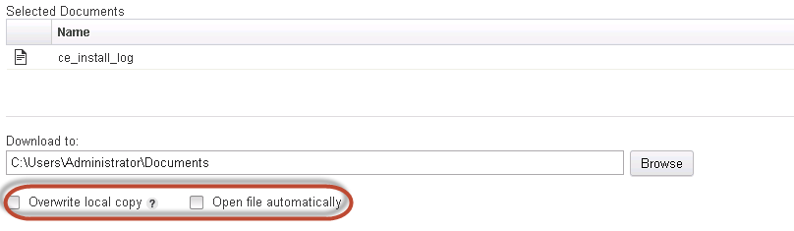
Utilizing file tracker
In Case Client run-time, when case workers check out a document, we can invoke the file tracker dialog when we click browse to specify a file to check out in the Case Information widget
We also have options to overwrite the local copy and open the file automatically

Slide 16
Course Roadmap
  Configuring themes with desktops
  Utilizing file tracker
  Utilizing entry templates
  Utilizing add to favorites with sync
  Zero Download Viewer Support
  Social Information for Case Documents
  ICN migration notes

Slide 17
Utilizing entry templates
Content Navigator 2.0.3 adds support for entry templates to streamline and control adding documents and folders to the repository
The Content Navigator Administrator creates the entry templates
Using an entry template you can ensure that documents get
  Added to the correct folder structure
  Assigned the correct document class
  With the appropriate security settings
To support this new feature, Case Manager 5.2.1, introduces a new action to add a document with an entry template
Limitations: Case Manager 5.2.1 does not support the use of
  Folder entry templates
  Non-P8 as a repository for entry templates (CM8, CMOD, etc)

Slide 18
Utilizing entry templates
General Use Case
  Adding documents into a content repository can often be time consuming and confusing if doc class, doc properties, and security is required
  A user must also know to select the correct document class in the first place
Specific Use Case
  A user is adding an incident report document into their case
  The solution has a document class defined for that type of document that includes several pieces of meta data that need to be entered by the end users
  An Entry Template is created that uses the case’s incident report doc class
  It also sets default security and predefines any default meta data values
  An ICM toolbar button or menu named “Add Incident Report” is added to the case details page using ICM’s new Entry Template action
  The user is now taken directly into the correct Entry Template, reducing clicks and the chance of error

Slide 19
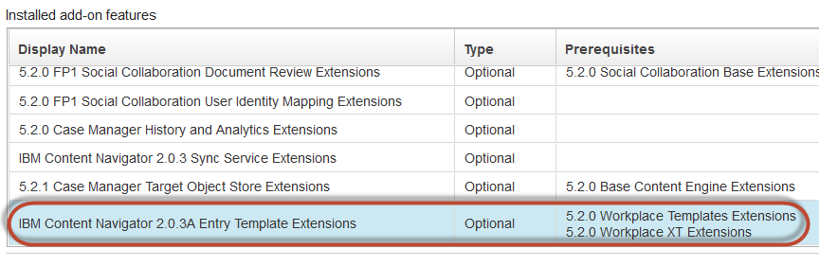
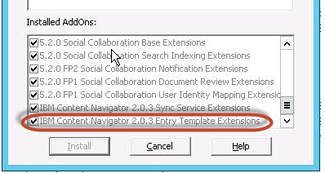
Utilizing entry templates
To configure entry templates in ICN, make sure that the new ICN add-ons for entry templates are installed on the TOS. Do this via ACCE or FEM
ACCE
FEM

Slide 20
Utilizing entry templates
To configure entry templates in Case Manager
Open the Content Navigator admin page and enable entry template management under Configuration Parameters under ICN Repositories.
Set the appropriate permissions for your users under “assign entry template roles”

Slide 21
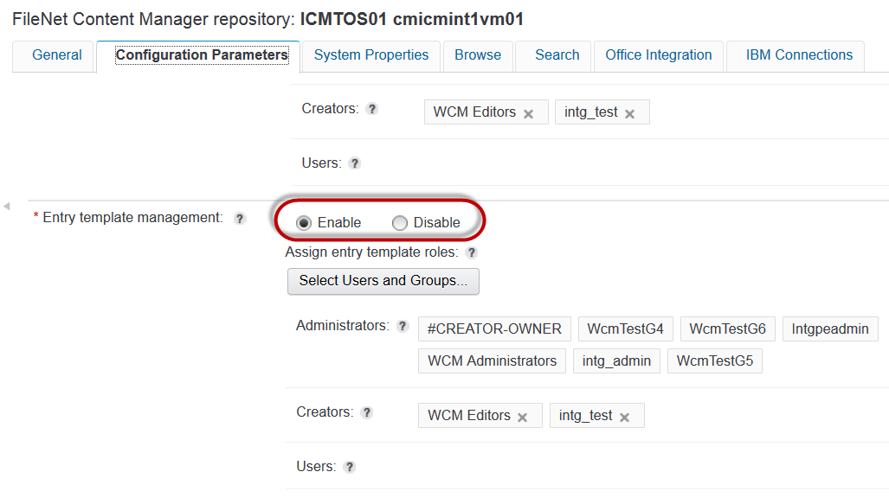
Utilizing entry templates

Slide 22
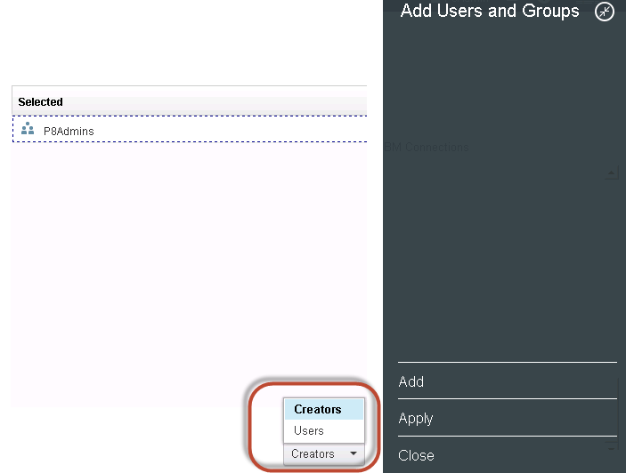
Utilizing entry templates
Then set the admin user as the “creator” in the dialog and case workers or other users as “users”

Slide 23
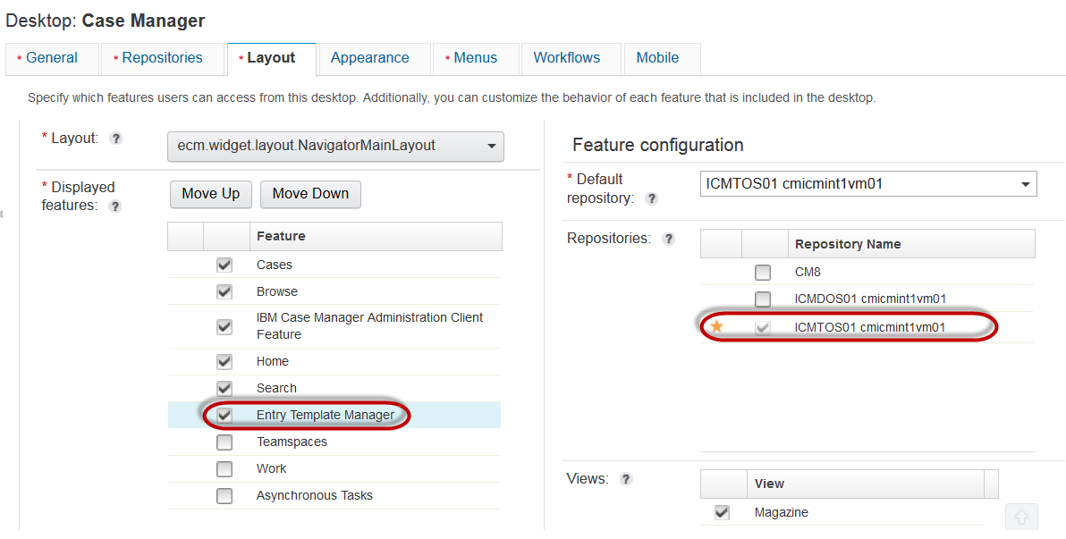
Utilizing entry templates
Open the Case Manager desktop in the ICN admin page and enable the entry template manager for use with the TOS

Slide 24
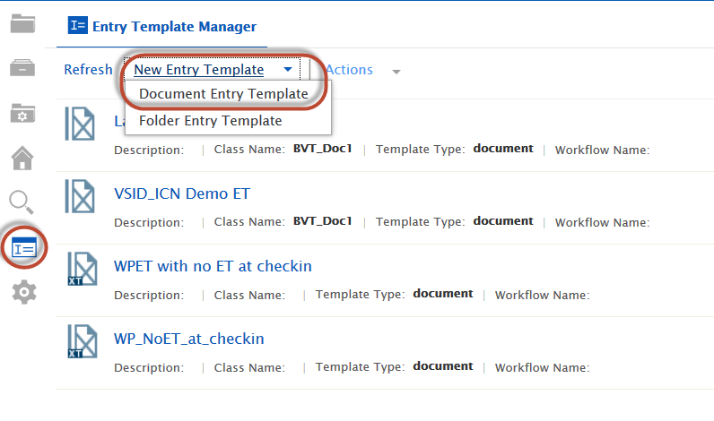
Utilizing entry templates
Open the entry template manager and design your entry templates

Slide 25
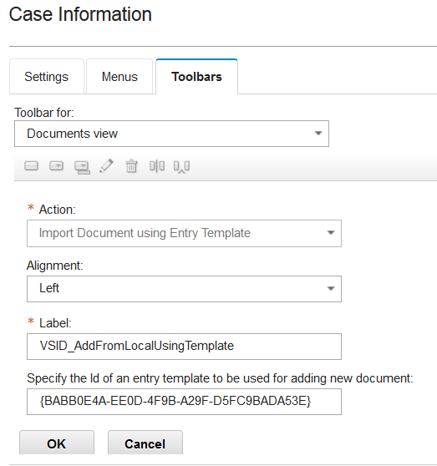
Utilizing entry templates
In Case Builder, configure menu or toolbar actions in the Case Information widget to use the Import Document using Entry Template action
5a. You can put a VSID during design time and make sure the user is enforced to use a specified ET
5b. You can leave the GUID out and there will be a drop down option in the UI to prompt the user to select an ET at run time

Slide 26
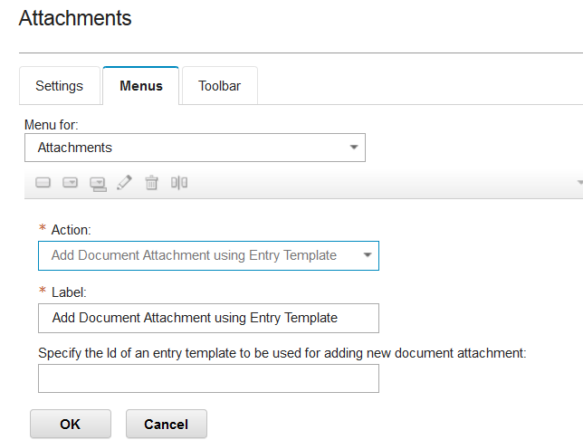
Utilizing entry templates
You can also configure the Import Document Attachment using Entry Template action on the Attachments widget

Slide 27
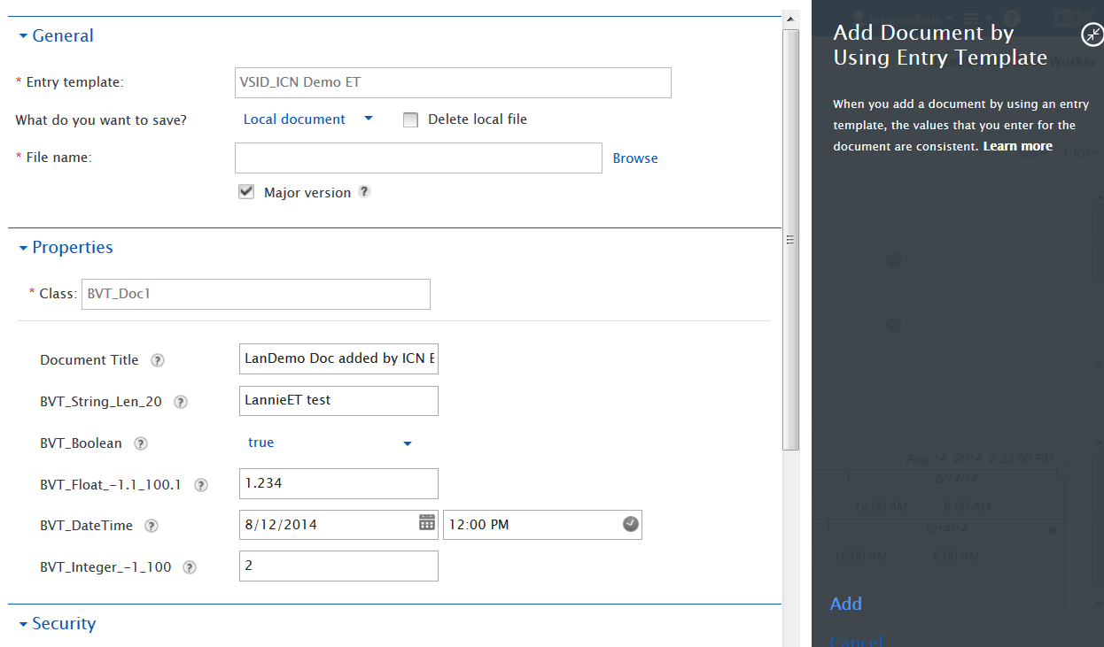
Utilizing entry templates

Slide 28
Utilizing entry templates
Test the new actions in Case Client to ensure that the appropriate
Entry templates are being invoked
Permissions are being applied to the different case roles

Slide 29
Course Roadmap
  Configuring themes with desktops
  Utilizing file tracker
  Utilizing entry templates
  Utilizing add to favorites with sync
  Zero Download Viewer Support
  Social Information for Case Documents
  ICN migration notes

Slide 30
Utilizing Add to Favorites with Sync
General Use Case
  Working with documents that reside in a content repository often requires extra user actions
  Users would like to streamline the number of clicks needed, while still benefiting from an ECM environment
Specific Use Case
  A user checks out and downloads a document from a case that they are going to edit on their local machine
  The system remembers where they like to keep their downloaded files
  When the user checks the file back in, the system remembers where the document was downloaded and does not make you search for it
  When a user is actively working on a set of favorite files, the system can keep the online and offline files automatically synchronized so the latest version is always available in both places

Slide 31
Utilizing Add to Favorites with Sync
Content Navigator 2.0.3 introduces a Sync feature that enables users to synchronize their favorite folders and documents
Sync allows the user to sync files between the server and the user's local client to get the latest files
See ICN PxT on Sync for detailed instructions about how to install the Sync Client on the workstation
Sync requires the workstation to have Sync Client installed and for sync to be enabled and configured on the ICM desktop via ICN admin

Slide 32
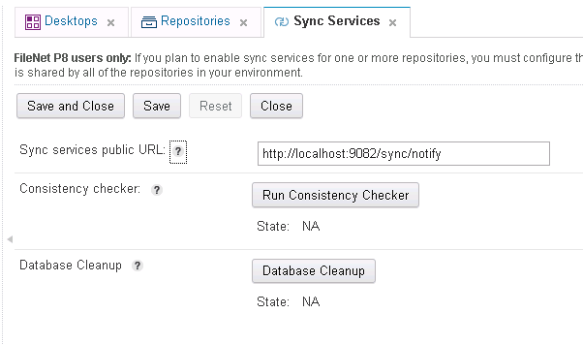
Utilizing Add to Favorites with Sync
1. To configure the new sync feature, enter sync services public URL on the Sync Services page under ICN admin. The port number is typically the port number that ICN/ICM uses

Slide 33
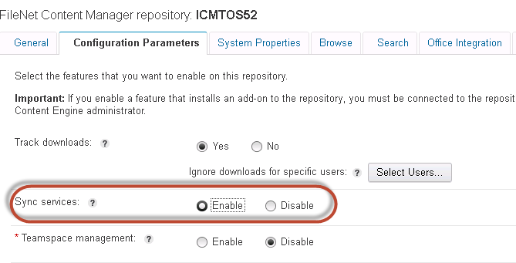
Utilizing Add to Favorites with Sync
Enable sync services under your target object store in ICN admin
2a. Make sure you have already installed the add-ons for sync services for your TOS in ACCE before

Slide 34
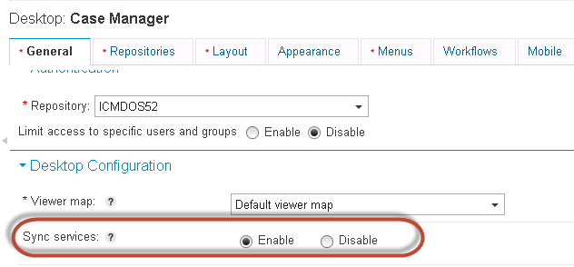
Utilizing Add to Favorites with Sync
3. To configure the new sync feature, navigate to the Case Manager desktop and under Desktop Configuration, enable Sync services

Slide 35
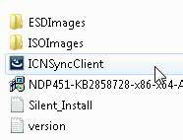
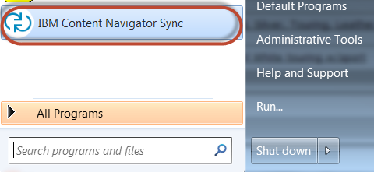
Utilizing Add to Favorites with Sync
Launch ICN Sync Client installer on your local client, follow the on-screen instructions
4a. The ICN Sync Client installer comes in the sync folder that is bundled under ICN installation
Once you finish installing, the ICN Sync Client will appear on your computer

Slide 36
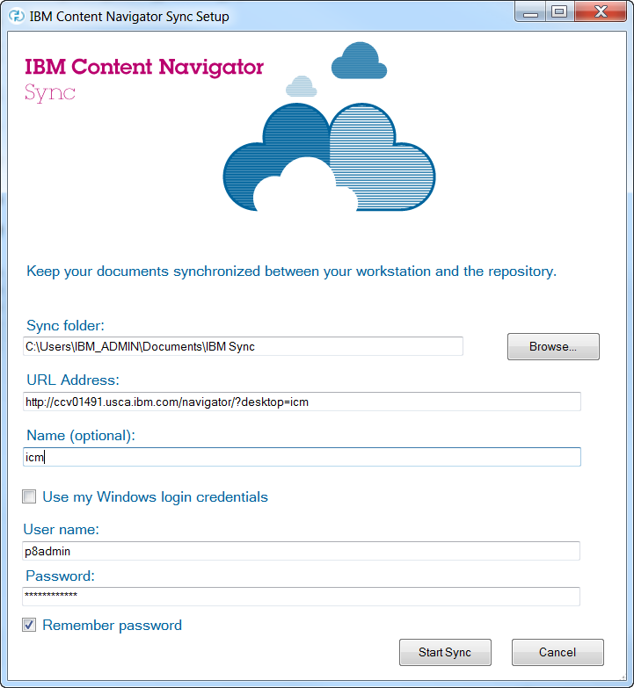
Utilizing Add to Favorites with Sync
Launch the Sync Client and then complete the configuration screen on the workstation

Slide 37
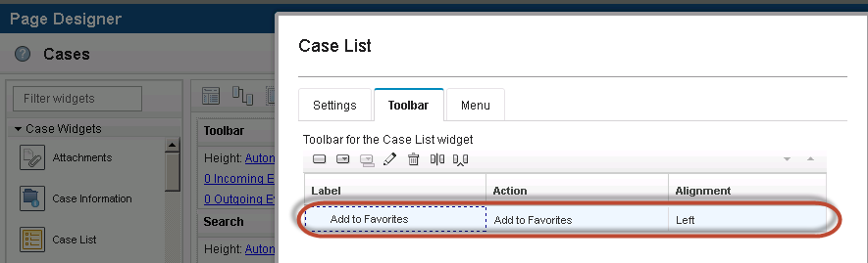
Utilizing Add to Favorites with Sync
In order to add a case, document in a case, or folder in a case to the ICN favorites view, configure the solution to use the “add to favorites” action in Case Builder.
7a. Add the “add to favorites action” to the Case Information Widget as a toolbar button on the Cases page, so that the case worker can add it to their favorites list in Case Client

Slide 38
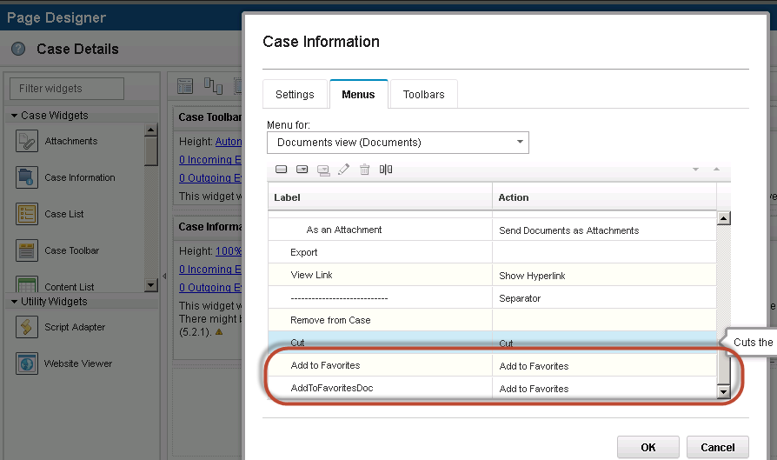
Utilizing Add to Favorites with Sync
You can also use the new feature on the Case Details page for the Case Information widget, so that case workers can identify case documents and folders as favorites

Slide 39
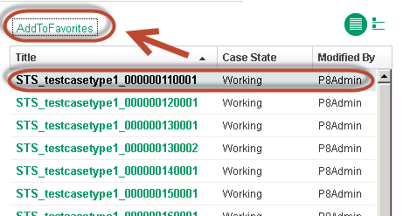
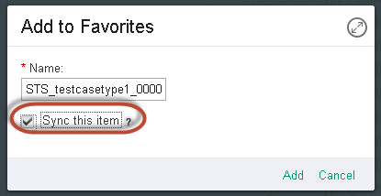
Utilizing Add to Favorites with Sync
In the example below, the first case in Case List widget is added as a favorite. It picks up the case ID automatically as the favorite name.
You can also configure the case title to be a case property in Case Builder

Slide 40
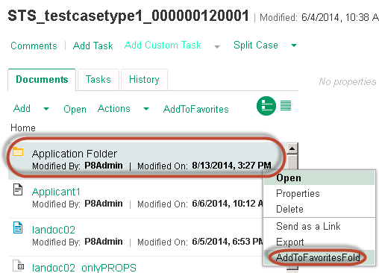
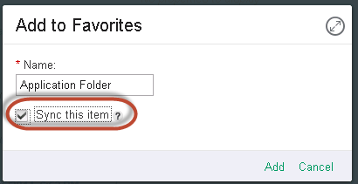
Utilizing Add to Favorites with Sync
Can also “favorite” documents and folders inside the same or different cases

Slide 41
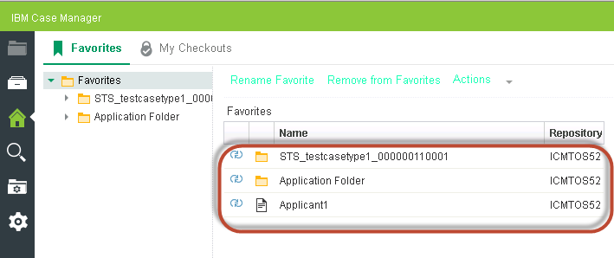
Utilizing Add to Favorites with Sync
In Case Client, browse to the favorites page to see the listed items. Items that are being synced are marked by a sync indicator

Slide 42
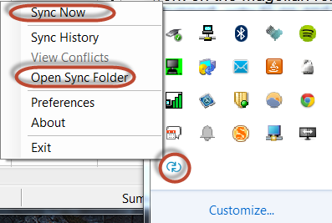
Utilizing Add to Favorites with Sync
Use the ICN Sync Client to open the sync folder or force a sync using the task bar “Sync Now” action.

Slide 43
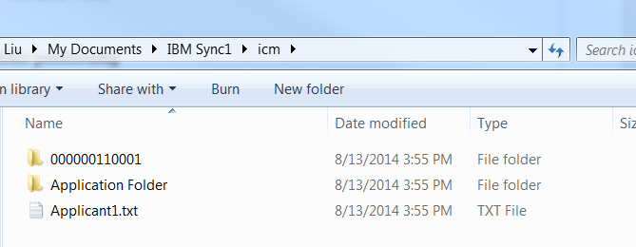
Utilizing Add to Favorites with Sync
We now see the sync items in the workstation's target location after sync runs manually or over an interval of time

Slide 44
Utilizing Add to Favorites with Sync
External docs are not supported with ICN sync
You can add an external document to the favorites view, but there will not be an option to sync it.
Sync is also not supported on non-P8 repositories

Slide 45
Course Roadmap
  Configuring themes with desktops
  Utilizing file tracker
  Utilizing entry templates
  Utilizing add to favorites with sync
  Zero Download Viewer Support
  Social Information for Case Documents
  ICN migration notes

Slide 46
Zero Download Viewer Support
General Use Case
  Viewing a document that resides in a content repository used to require an initial acceptance and download of a large viewer java applet
  Although feature rich, the viewer applet may not be required by all users
  The viewer applet may also not be supported on all user devices
Specific Use Case
  A case folder has a spreadsheet document filed in it that a user needs to review quickly
  When they click the document, it is rendered on the server and quickly delivered to the case’s Viewer widget
  No long applet downloads or startup is required to view the spreadsheet

Slide 47
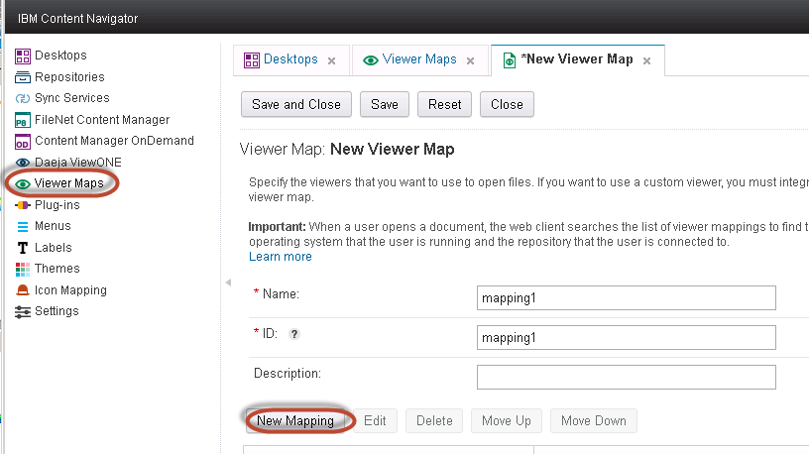
Zero Download Viewer Support
In order to configure zero download viewer support, ensure that you have a Daeja license for the office module first
Next, create a custom viewer map in ICN admin tool and create a new mapping

Slide 48
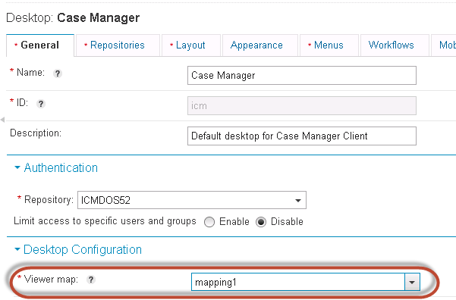
Zero Download Viewer Support
Save and close your newly created viewer map
Go to the Case Manager desktop in ICN admin and select your newly created viewer map

Slide 49
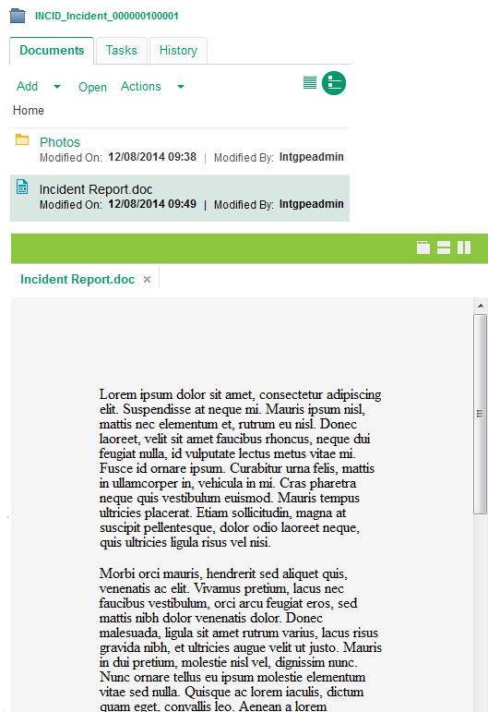
Zero Download Viewer Support
ICM Viewer page widget supports the new ICN zero download document viewer
Documents that are part of a case can be viewed directly on the page without requiring a download of the viewer applet
Documents of many formats are rendered quickly on the server and delivered for viewing to the client
Office document rendered on server and displayed in the ICM Viewer widget

Slide 50
Course Roadmap
  Configuring themes with desktops
  Utilizing file tracker
  Utilizing entry templates
  Zero Download Viewer Support
  Social Information for Case Documents
  ICN migration notes

Slide 51
Social Information for Case Documents
General Use Case
  When collaborating on a case with a team of knowledge workers, it is often helpful to know when case documents have been downloaded or liked
  Tagging provides a quick way of categorizing related documents; making them easier to find later
Specific Use Case
  A case worker has added a set of documents to a case folder
  Over the next several days, the worker is able to see who downloaded the documents, who liked the content, and tag it with keywords that can help other users of the content locate it quickly

Slide 52
Social Information for Case Documents
To configure social information for ICM, you first must have the social collaboration add-ons installed on your TOS first in FEM or ACCE:
  5.2.0 Social Collaboration Role Extensions
  5.2.0 Social Collaboration Base Extensions
  5.2.0 Social Collaboration Search Indexing Extensions
  5.2.0 FP2 Social Collaboration Notification Extensions
  5.2.0 FP2 Social Collaboration Document Review Extensions
  5.2.0 FP1 Social Collaboration User Identity Mapping Extensions
  5.2.0 Teamspace Extensions
  5.2.0 Custom Role Extensions

Slide 53
Social Information for Case Documents
Go to the TOS repository for ICM in ICN admin tool and expose comments, downloads, likes, and tag properties under System Properties, Browse, and Search tabs
Optionally, configure track downloads under the TOS which tracks the download for file tracker. This is for the social track download that records the number of times the file was downloaded

Slide 54
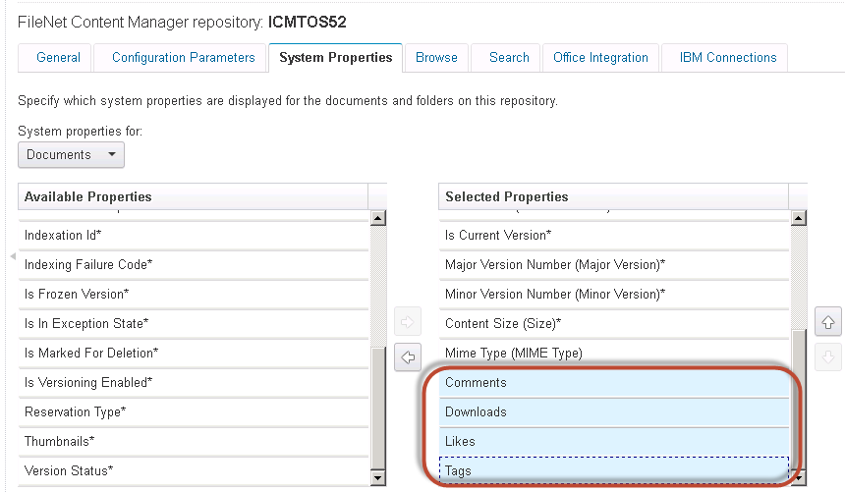
Social Information for Case Documents

Slide 55
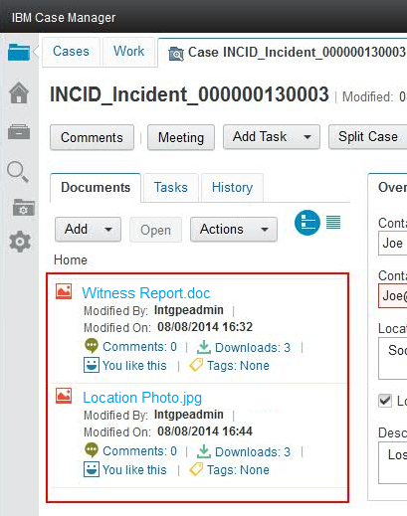
Social Information for Case Documents
Social information like comments, tags, likes and download counts are maintained natively in an object store by the Content Platform Engine.
This information is optionally displayed directly in the document magazine view or in a document’s property page

Slide 56
Course Roadmap
  Configuring themes with desktops
  Utilizing file tracking
  Utilizing entry templates
  Utilizing add to favorites with sync
  Zero Download Viewer Support
  Social Information for Case Documents
  ICN migration notes

Slide 57
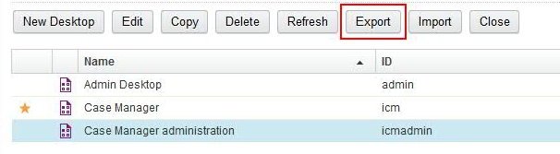
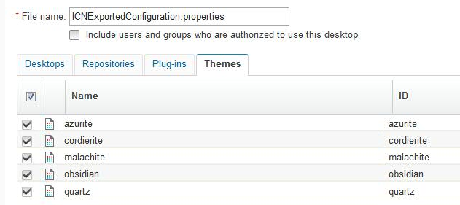
ICN Migration Notes
If your application includes configuration information that is managed with IBM Content Navigator, such as a customized desktop with its associated themes, you must use the Desktop > Export and Import operations in the ICN administration client.

Slide 58
ICN Migration Notes
If your application includes assets that are managed by FileNet® P8, such as ICN entry templates, use FileNet Deployment Manager for migration and deployment tasks that are related to those assets.
  Tip: FileNet Deployment Manager does not recognize objects that may be referenced in the document contents of the IBM Content Navigator asset. Therefore you must specifically add these referenced objects to the export manifest or ensure that they are present in the destination environment before the IBM Content Navigator asset is used in the destination environment. The IBM Content Navigator asset must be edited after it is imported to correct portions that might be invalid relative to the destination environment such as user names or repository identifiers.
The ICM configuration tool will create repositories for both DOS/SOS and TOS including IBM Case Manager API plug-in, IBM Case Manager administration plug-in, IBM Case Manager client plug-in, custom widgets packages, and custom extension packages
For more information about migrating ICN artifacts, see the ICN Knowledge Center, ICN 2.0.3 PxTs, and the P8 5.2.1 Info Center when available

Slide 59
ICN Migration Notes (some warnings)
There is no ability to export favorites
The ICN export/import will not modify the configuration objects that are being migrated
  The JAR file will not be migrated with the plug-in configuration
  The plug-in configuration will still reference the JAR in the original file path
  Solution is to copy JAR to exact same location on migrated system or manually recreate the plug-in configuration
The repository will reference the original CPE server and object store
  If this is not suitable for the user, then the user should not migrate the repository
  The desktop still references the plug-ins and repositories so the user would need to re-create the plug-ins and create new repositories
Use the ICN admin web client to verify and correct the imported desktop configuration, plug-in registrations, entry templates, and other ICN assets that may contain references to repositories, groups and users, objects or system elements and file paths present in the source environment.

Slide 60
Course Summary
You have completed this course and can:
Understand how to configure a theme with IBM Case Manager desktop
Use file tracking in IBM Case Manager
Use entry templates in IBM Case Manager
Use add to favorites action with IBM Content Navigator Sync
Use zero download to view office documents in IBM Case Manager
Use social information in IBM Case Manager
Understand ICN migration areas

Slide 61
Contacts
Product Marketing Manager:
William (Doc) Mills (wdocmills@us.ibm.com)
Product Manager:
Dave Perman (dperman@ca.ibm.com)
Support:
Ted Dullanty (tdullanty@us.ibm.com)
Subject Matter Experts (SME)/Area of Expertise:
Lauren Mayes

Slide 62
Product Help/Documentation/Resources
IBM Case Manager Knowledge Center
http://www-01.ibm.com/support/knowledgecenter/SSCTJ4_5.2.1/com.ibm.casemgmttoc.doc/casemanager_5.2.1.htm?lang=en
ICN 2.0.3 PxTs
IBM Content Navigator 2.0.3 Knowledge Center http://www.ibm.com/support/knowledgecenter/SSEUEX_2.0.3/contentnavigator_2.0.3.htm

